Slide 1
KERYANA STORE DATABASE PROJECT
First Member
Name Muhammad Ahmed Ramzan
Sapid 23402
Name Afnan Amjad
Sapid 23068

Slide 2
INTRODUCTION
Online grocery Store is a way of buying products and other household necessities using a web-based shopping service. There are two basic methods that people can use to purchase these items online. One is to order them from a local general(Keryana) store that participates in online shopping.
Moreover the basic function of project is to store data of user,products,and Courrier service.

Slide 3
Why we are making this project?
The main reason is that we can store data of products and user in large amount and we can access it at any time anywhere in the world.
Moreover we can calculate the sum of products easily.
Furthermore we can access easily record of specific person.
Online general store saves the time of people because people can order products at his home at any time.

Slide 4
Advantages of online general store
Saves time and efforts.
Convenience of Shopping at home.
Wide variety / range of products are available.
Good discounts / lower prices.
Get detailed information of the product.
We can compare various models / brands.

Slide 5
Disadvantages of online general store
Delay in delivery. ...
Lack of significant discounts in online shops. ...
Lack of touch and feel of merchandise in online shopping. ...
Lack of interactivity in online shopping. ...
Lack of shopping experience. ...
Lack of close examination in online shopping. ...
Frauds in online shopping.

Slide 6
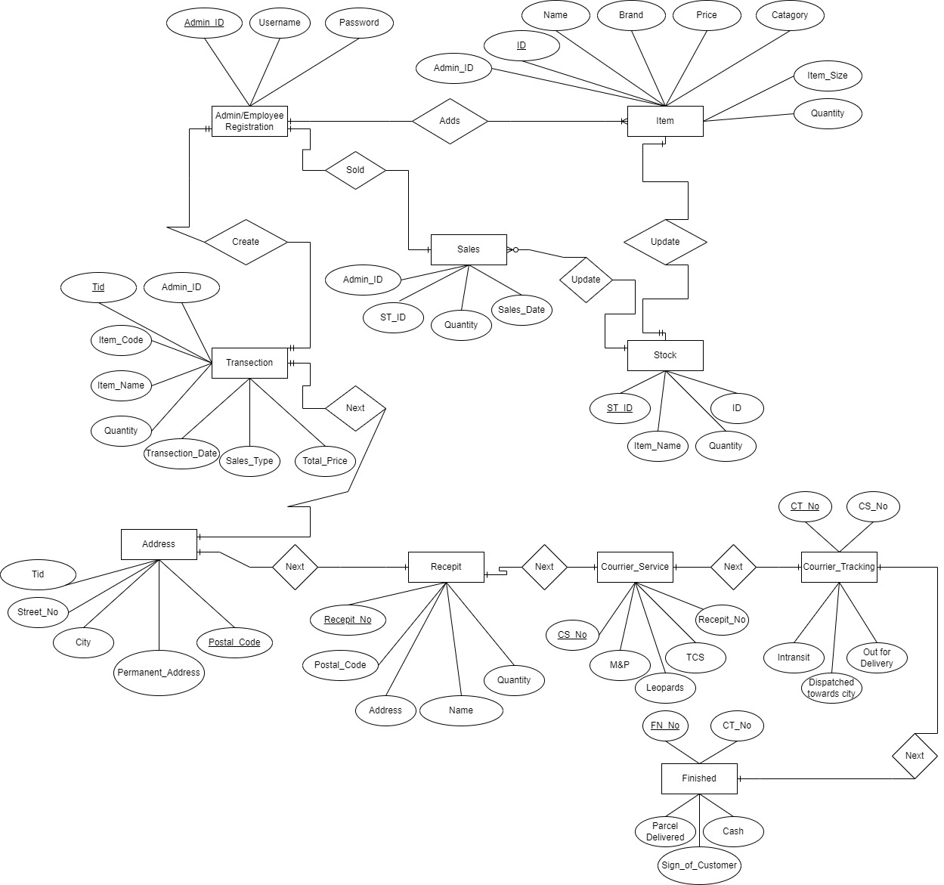
ERD Diagram of Semester project

Slide 7
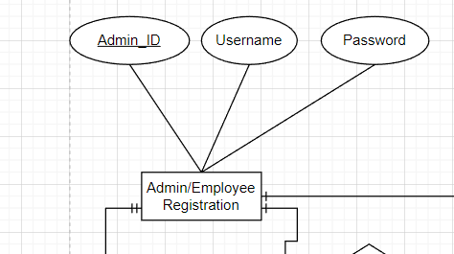
Employee Registration
It store the username and password of employee.
It store the Admin_ID of the Admin or Employee.
In database their will be only register table because login table takes value from database and it show on front end of project.

Slide 8
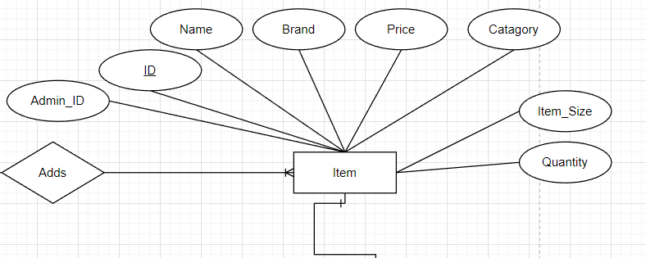
Item Table
It store the information of products Name,Price,Category,Brand and quantity of items
Furthermore the item table has one to many relation with admin table as shown in above ERD diagram
In above table Admin_ID use as a Foreign Key because it is primary key in the Employee Registration table.So it links Admin/Employee Registration table with item
One to many relation is shown between Item and Admin because admin can add many items in database

Slide 9
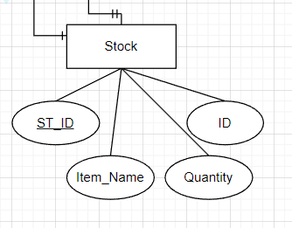
Stock Table
Stock table store data of item_Name,Item quantity and when order is confirmed it updates the quantity of products.
Furthermore stock table is linked with Item table, Hence Id is used as a foreign key

Slide 10
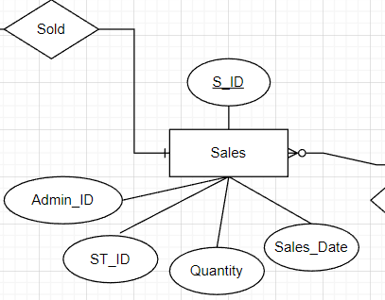
Sales Table
It store data of Sales date and quantity. Etc
Moreover sales table link with more two tables. So it has two foreign key like Admin_ID and ST_ID

Slide 11
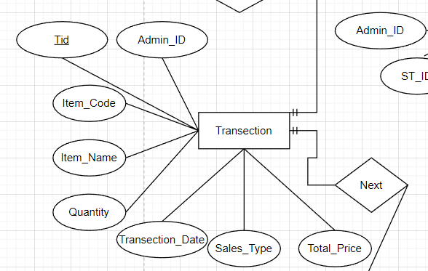
Transection Table
It store different information like total price and transection date in database.
Here Tid is primary key so if we find specific data then we can find easily with the help of primary key.
Moreover it links with admin table as shown in above ERD diagram

Slide 12
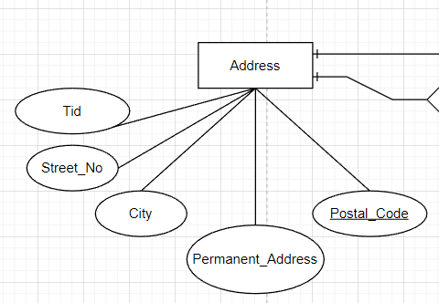
Address Table
It store street No of buyer
It store city of buyer’s in data base
It store postal code and payment address
Tid is Foreign key here so it links with another table(Transection)
It has one to one relation because one transection record has one specific address

Slide 13
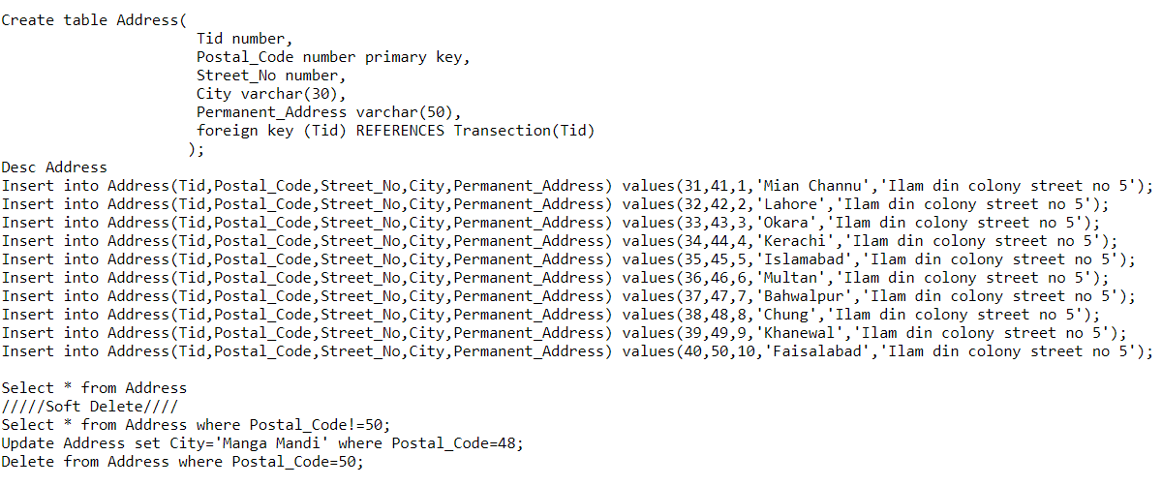
Create Table and CRUD

Slide 14
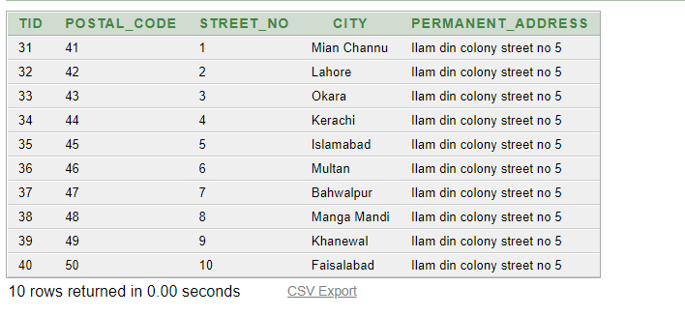
Output of above table

Slide 15
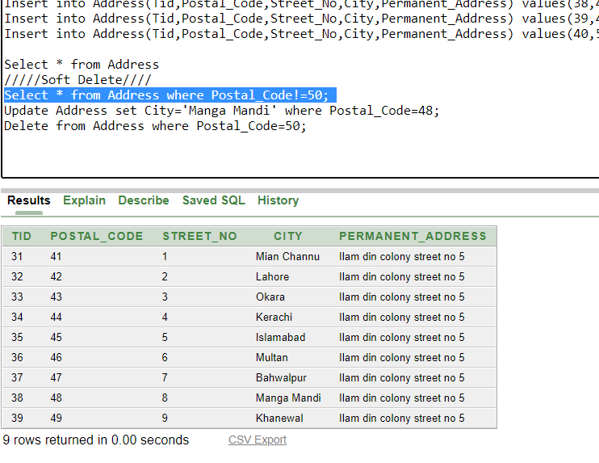
Soft Delete

Slide 16
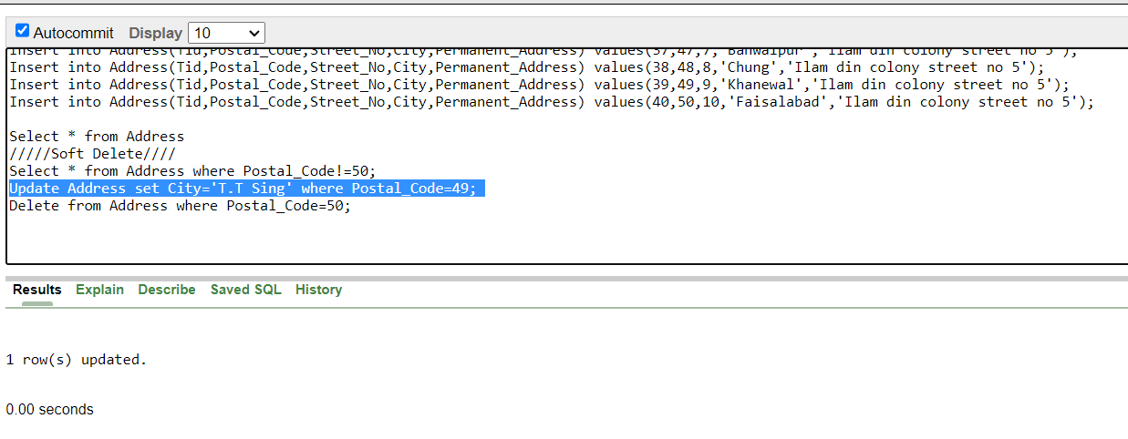
Update

Slide 17
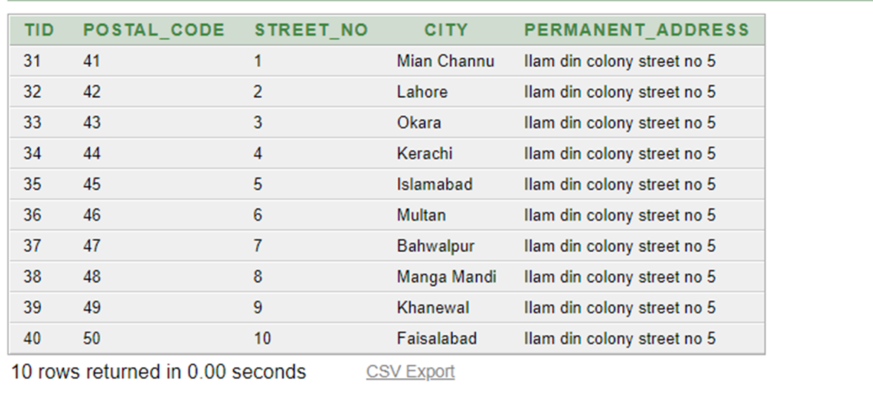
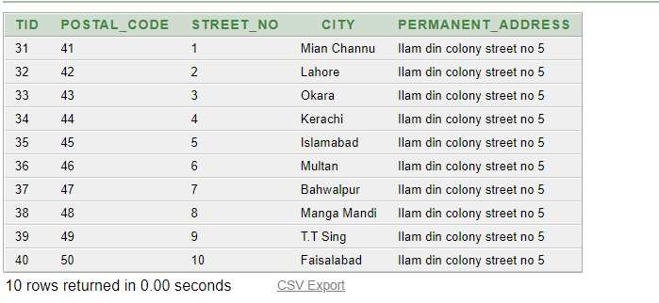
Previous Table
Updated Table

Slide 18
Thankyou

